Slide 1


QUESTIONS
DATA ANALYTICS (ONLINE)
DATA SUMMARY
DATA EXPLORATION
The impact of COVID-19 in relation to
Unemployment
Crime
In the Kansas City Missouri Area
ANALYSIS
SUMMARY
IMPLICATIONS
Team Members:
Natalie Shaw
Eric Weber
Kevin Smith
FOR REVIEW
GROUP 4: PROJECT 1

Slide 2
QUESTIONS
DATA ANALYTICS (ONLINE)
DATA SUMMARY
HYPOTHESIS
Covid-19 rates in the Kansas City Metropolitan area have had an impact on
Crime
2) Unemployment rates for the time period of
October 2019 – December 2020
DATA EXPLORATION
ANALYSIS
SUMMARY
IMPLICATIONS
FOR REVIEW
GROUP 4: PROJECT 1

Slide 3



QUESTIONS
DATA ANALYTICS (ONLINE)
Stages
CRIME
COVID -19
UNEMPLOYMENT
1
DATA SUMMARY
NATALIE SHAW
KEVIN SMITH
ERIC WEBER
DATA EXPLORATION
2
ANALYSIS
NATALIE SHAW
KEVIN SMITH
ERIC WEBER
3
SUMMARY
COVID -19
COVID -19
CRIME
UNEMPLOYMENT
GitHub Manager
Eric Weber
IMPLICATIONS
MINING
COVID -19
4
NATALIE SHAW
UNEMPLOYMENT
ERIC WEBER
FOR REVIEW
ANALYSIS
CRIME
KEVIN SMITH
GROUP 4: PROJECT 1 (PLANNED STAGES)

Slide 4
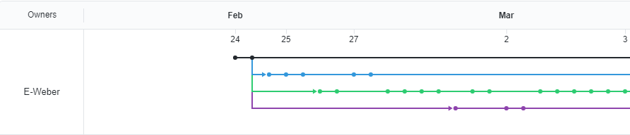
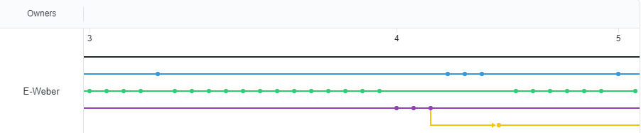
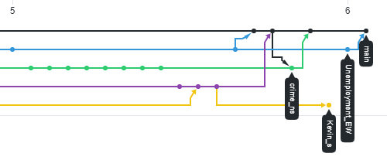
HYPOTHESIS
QUESTIONS
GITHUB INSIGHTS
DATA SUMMARY
Main
Natalie
Eric
Kevin
Kevin’ Test
DATA EXPLORATION
ANALYSIS
SUMMARY
February
March
IMPLICATIONS
FOR REVIEW
GROUP 4: PROJECT 1 (PLANNED STAGES)

Slide 5
QUESTIONS
DATA ANALYTICS (ONLINE)
DATA SUMMARY
Was there an impact on crime rates and unemployment due to the COVID-19 Pandemic in the Kansas City Metropolitan Area?
If so, can we discover a correlation between the variables?
Was there a rise in crime and if so what types?
Was the rise in crime due to unemployment? How can we highlight that relationship if one exists?
Did the COVID-19 pandemic influence one of the variables more than the other?
Was there any impact at all?
What should we use as benchmark (time wise)?
What kind of crimes were we going to use for our data?
Should we incorporate demographics?
DATA EXPLORATION
ANALYSIS
SUMMARY
IMPLICATIONS
FOR REVIEW
GROUP 4: PROJECT 1

Slide 6

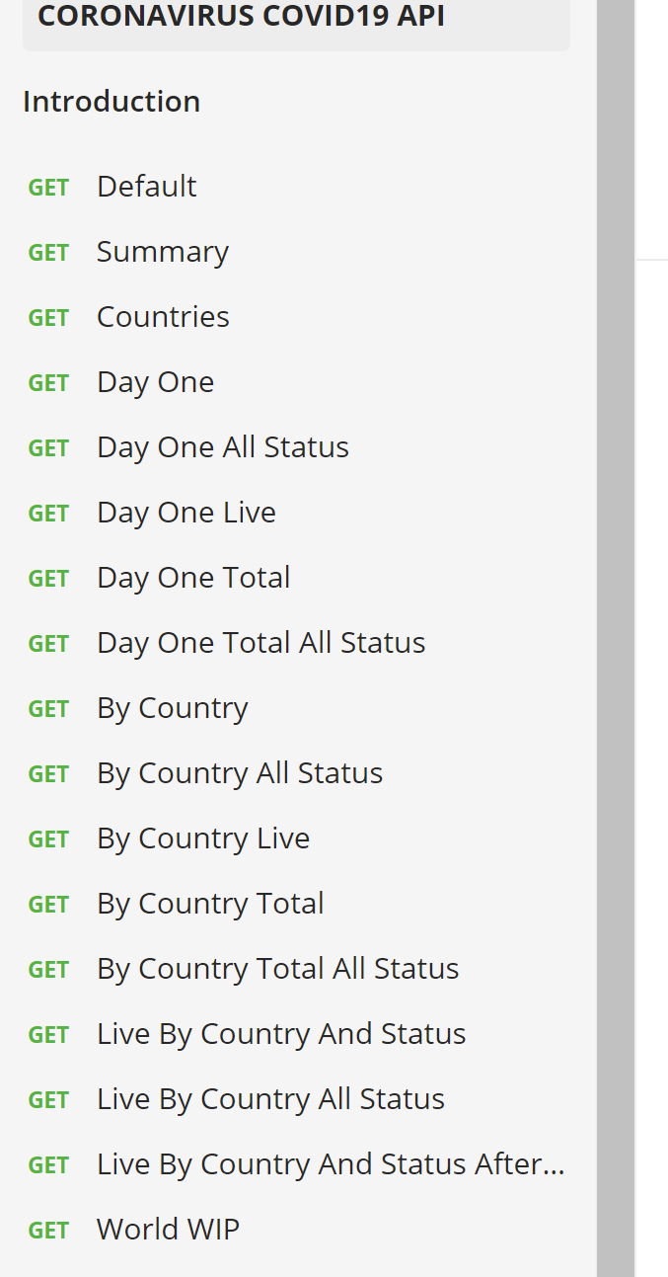
QUESTIONS
DATA ANALYTICS (ONLINE)
DATA SUMMARY
COVID-19
https://covid19api.com/
Free API on the coronavirus
Data is sourced from John Hopkins CSSE (Center for Science and Systems and Engineering)
Through Postman (at bottom of site)
You can get data pre-sorted by category
DATA EXPLORATION
ANALYSIS
SUMMARY
IMPLICATIONS
FOR REVIEW
GROUP 4: PROJECT 1

Slide 7

Start Date End Date Total Incidents
0 2019-10-01 2019-10-31 96
1 2019-11-01 2019-11-30 110
2 2019-12-01 2019-12-31 126
3 2020-01-01 2020-01-31 0
4 2020-02-01 2020-02-29 0
5 2020-03-01 2020-03-31 0
6 2020-04-01 2020-04-30 0
7 2020-05-01 2020-05-31 0
8 2020-06-01 2020-06-30 0
9 2020-07-01 2020-07-31 0
10 2020-08-01 2020-08-31 0
11 2020-09-01 2020-09-30 0
12 2020-10-01 2020-10-31 12478
13 2020-11-01 2020-11-30 13825
14 2020-12-01 2020-12-31 15196
QUESTIONS
DATA ANALYTICS (ONLINE)
DATA SUMMARY
CRIME
Data provided by instructor, Ben (thank you)
Incident-based crime API for KC Metro
Data from local police agencies
Location and incident type
Aggregated on a monthly basis
Volume and trends in crime over time
DATA EXPLORATION
Kansas City Police Dept.
Liberty Police
Riverside Dept. of Public Safety
Blue Springs Police Department
North Kansas City Police Dept.
University of Kansas Public Safety Office
St. Joseph Police Dept.
ANALYSIS
SUMMARY
IMPLICATIONS
FOR REVIEW
GROUP 4: PROJECT 1

Slide 8
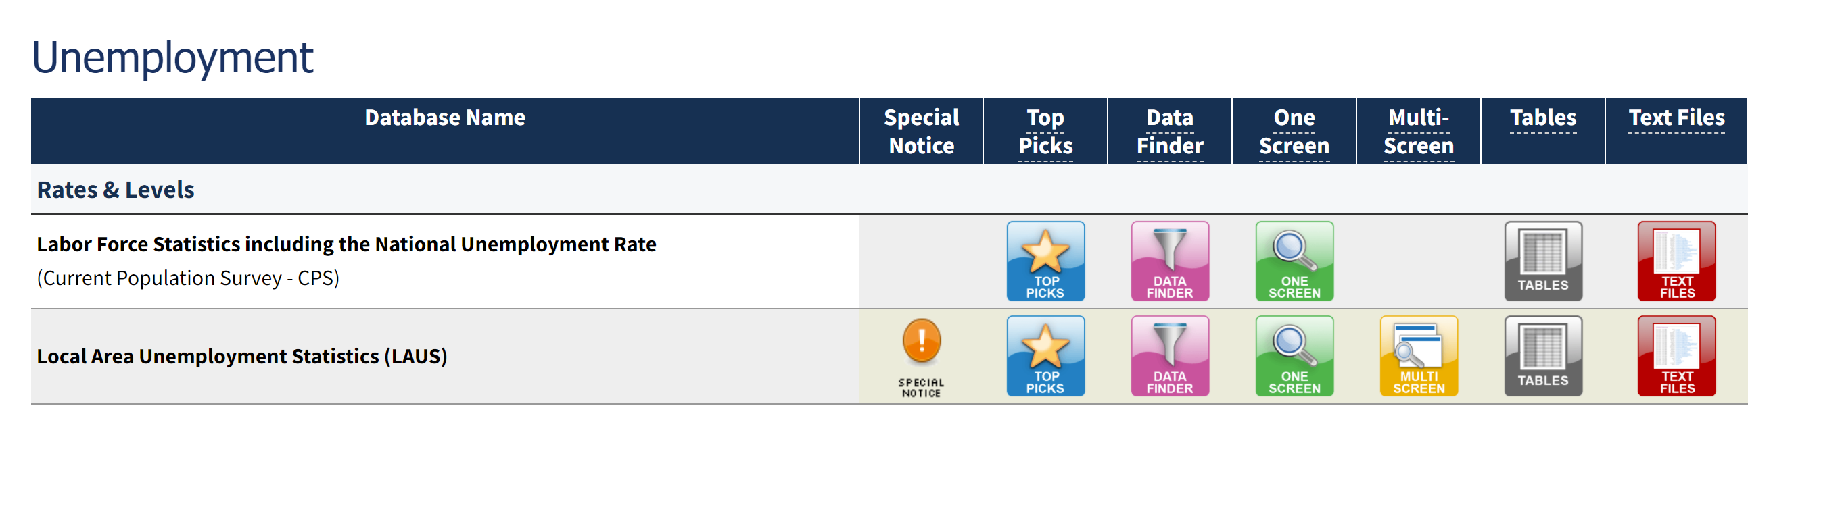
QUESTIONS
DATA ANALYTICS (ONLINE)
DATA SUMMARY
UNEMPLOYMENT
Unemployment data found at: https://www.bls.gov/data/#unemployment
Unemployment data collected on a monthly basis from Kansas City, Mo in 2019 and 2020 to show the impact COVID-19 had on the economy.
DATA EXPLORATION
ANALYSIS
SUMMARY
IMPLICATIONS
FOR REVIEW
GROUP 4: PROJECT 1

Slide 9
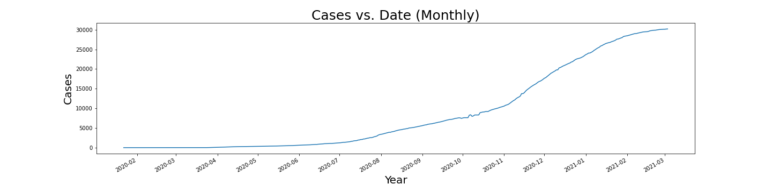
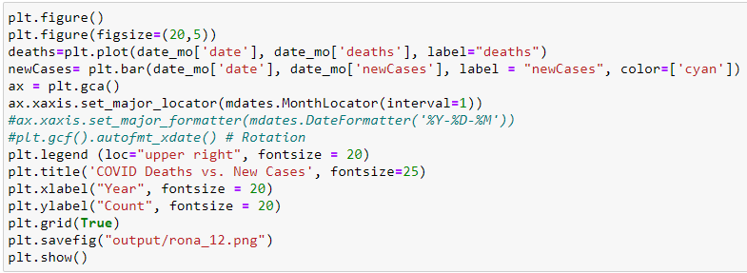

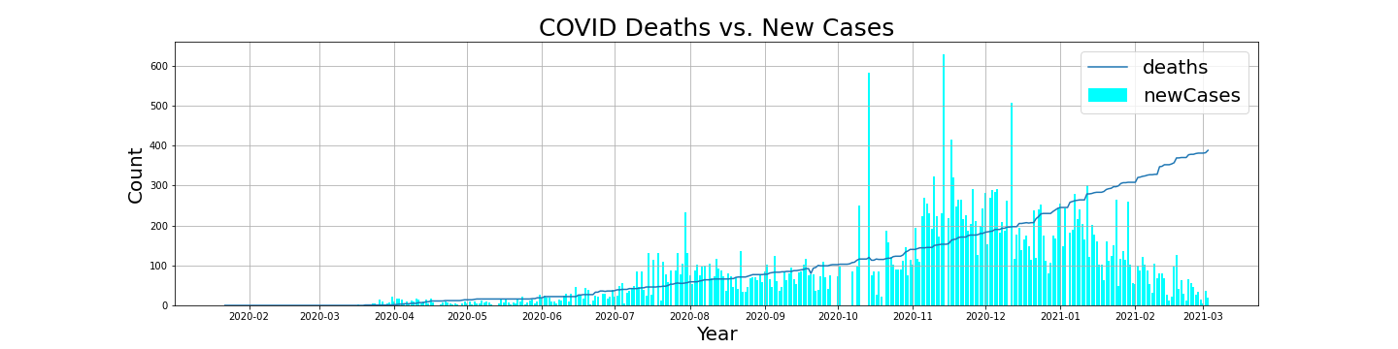
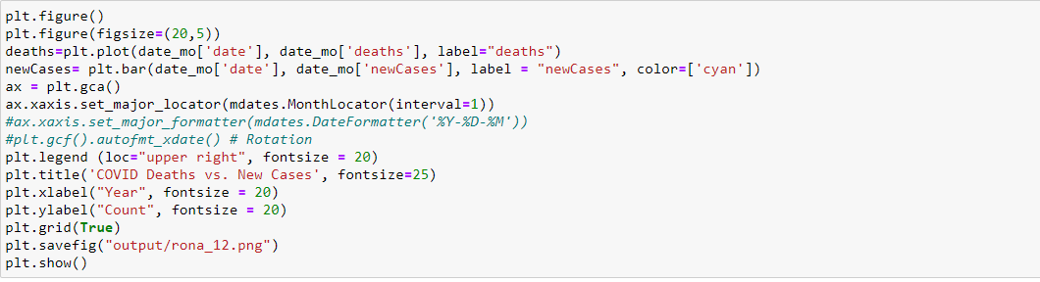
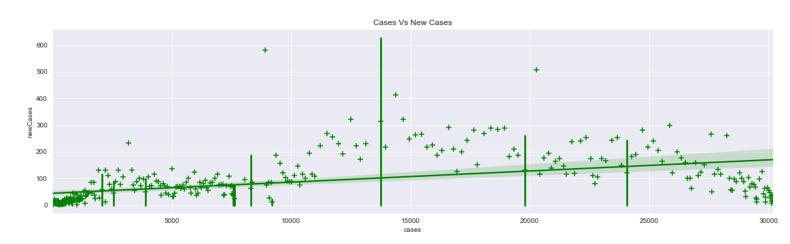
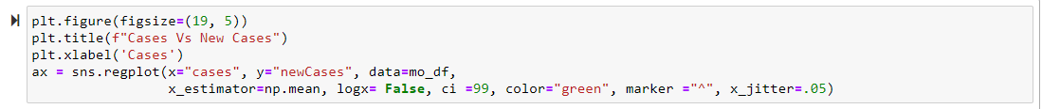
QUESTIONS
DATA ANALYTICS (ONLINE)
Linear vs. Non Linear equations (“The Baseline”)
DATA SUMMARY
DATA EXPLORATION
COVID-19
ANALYSIS
SUMMARY
IMPLICATIONS
FOR REVIEW
GROUP 4: PROJECT 1

Slide 10
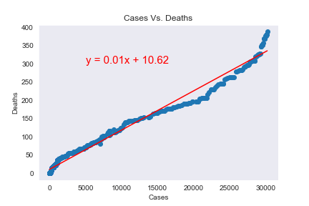
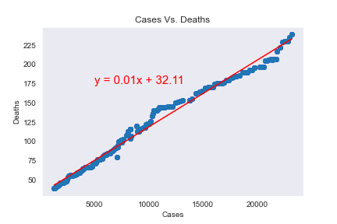
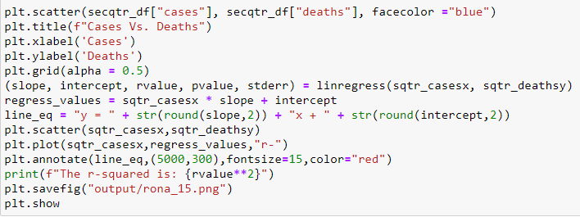
QUESTIONS
DATA ANALYTICS (ONLINE)
Correlation of Cases vs. Deaths
DATA SUMMARY
March 1st 2020 – June 30th 2020
July 1st 2020 – December 30th 2020
DATA EXPLORATION
COVID-19
ANALYSIS
SUMMARY
IMPLICATIONS
The r-squared is: 0.9825204775479639
The r-squared is: 0.9878841847717416
FOR REVIEW
GROUP 4: PROJECT 1

Slide 11
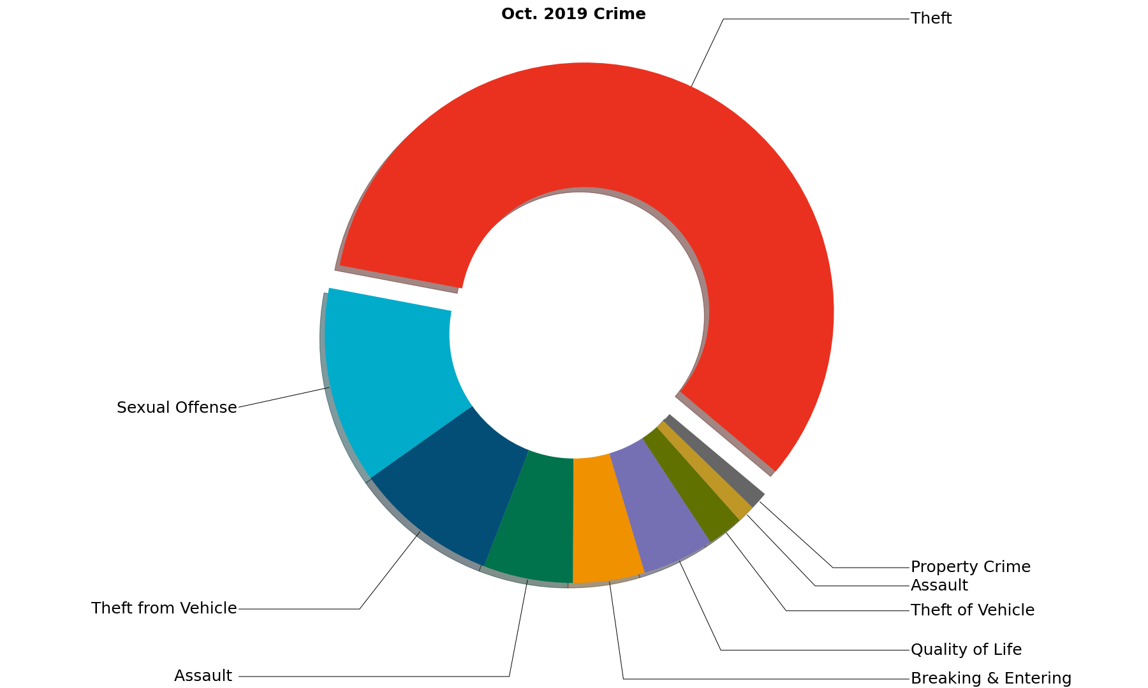
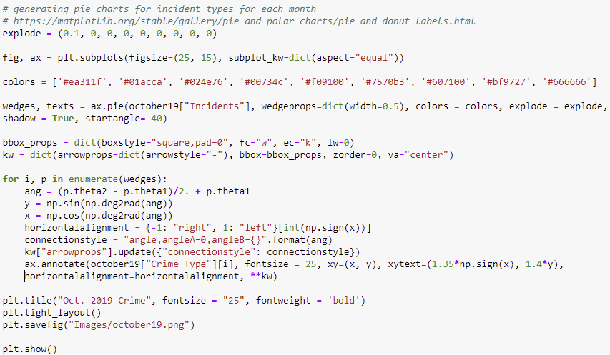
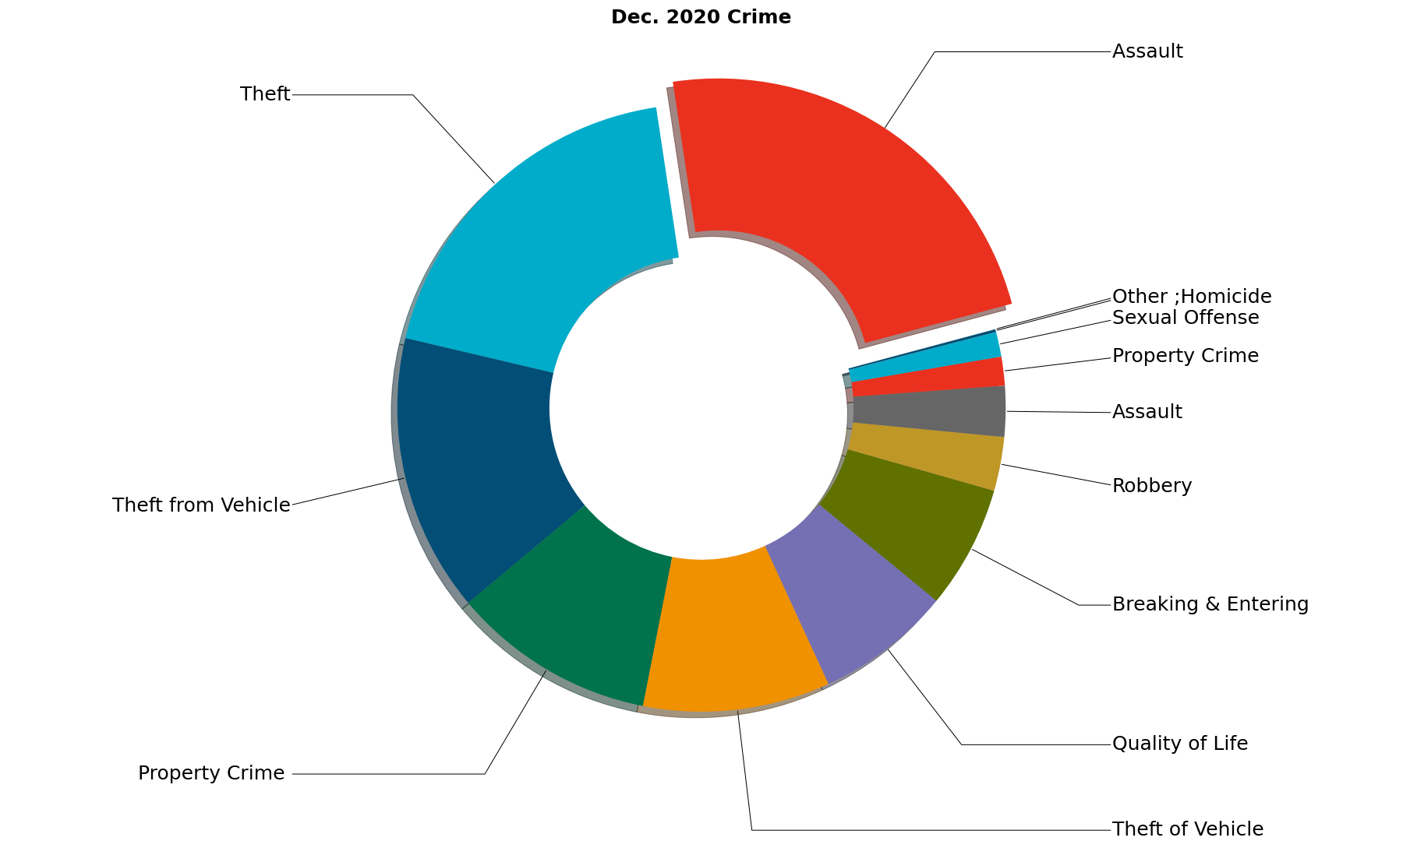
QUESTIONS
DATA ANALYTICS (ONLINE)
DATA SUMMARY
Crime Segments | Assault | Breaking & Entering | Homicide, Other | Property Crime | Quality of Life | Sexual Offense | Robbery, Theft, Theft from and of Vehicle
DATA EXPLORATION
CRIME
ANALYSIS
SUMMARY
IMPLICATIONS
FOR REVIEW
GROUP 4: PROJECT 1

Slide 12
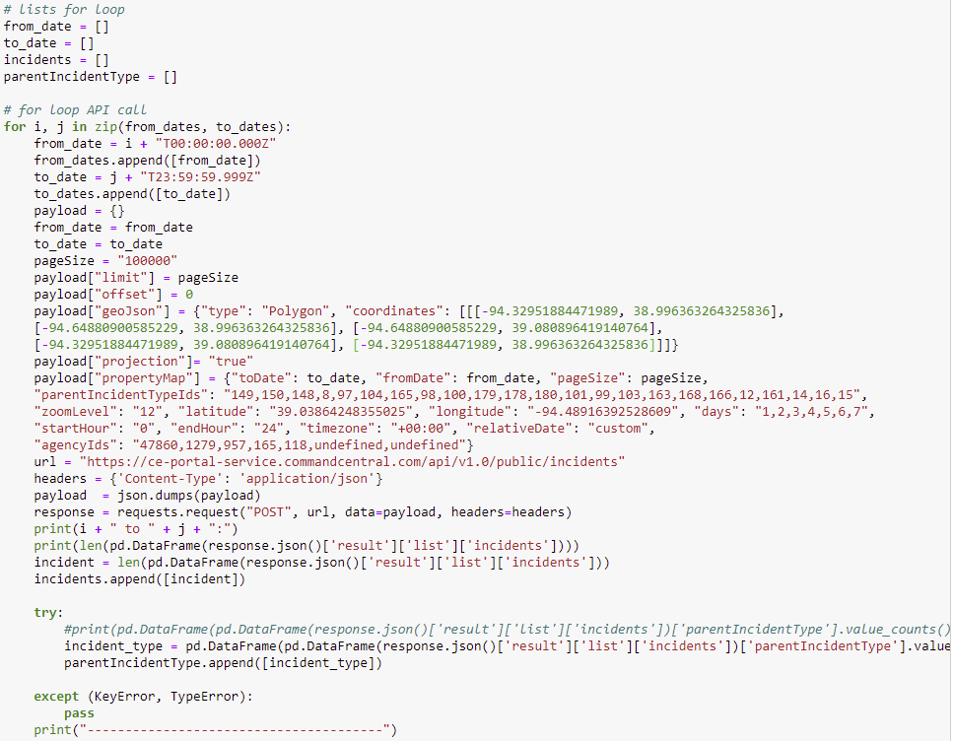
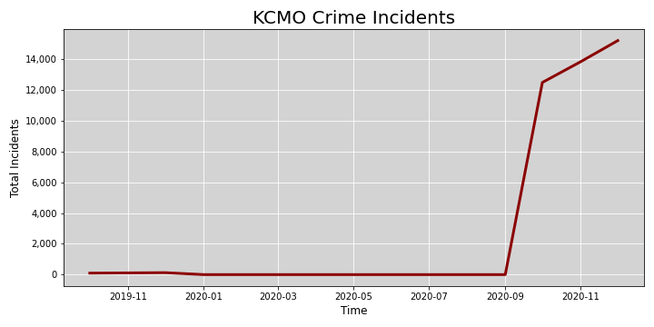
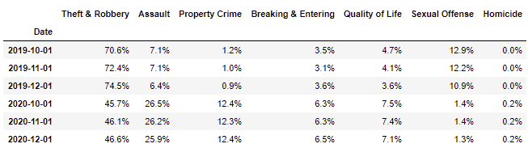
QUESTIONS
DATA ANALYTICS (ONLINE)
For Loop for API Call (Crime)
DATA SUMMARY
DATA EXPLORATION
CRIME
ANALYSIS
SUMMARY
IMPLICATIONS
FOR REVIEW
GROUP 4: PROJECT 1

Slide 13
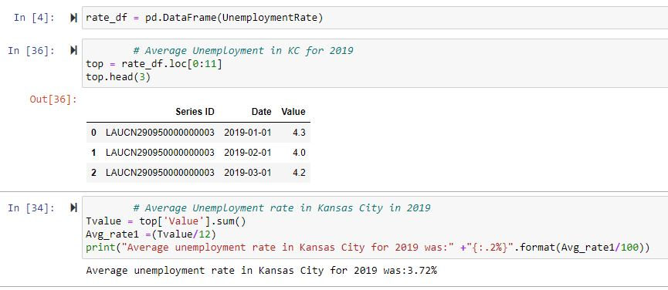
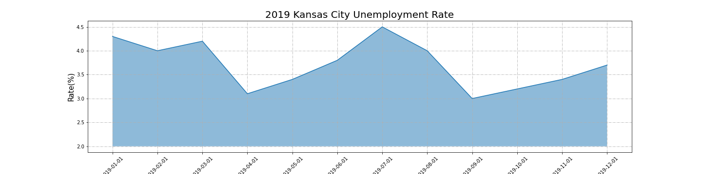
QUESTIONS
DATA ANALYTICS (ONLINE)
DATA SUMMARY
DATA EXPLORATION
UNEMPLOYMENT
ANALYSIS
SUMMARY
IMPLICATIONS
FOR REVIEW
GROUP 4: PROJECT 1

Slide 14
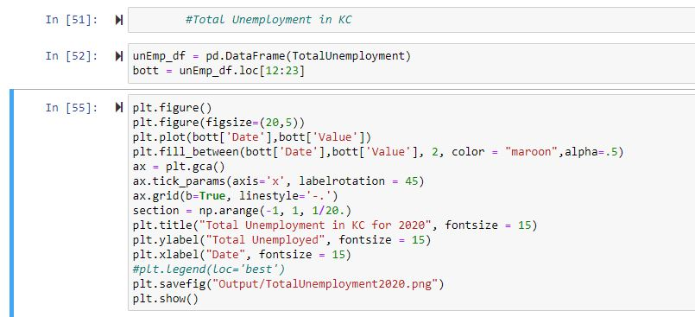
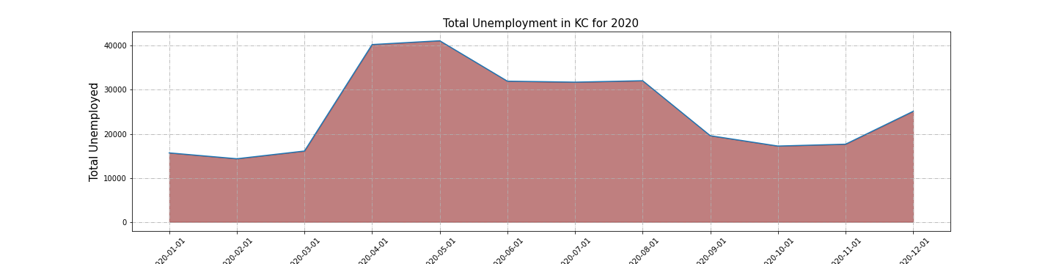
QUESTIONS
DATA ANALYTICS (ONLINE)
DATA SUMMARY
DATA EXPLORATION
UNEMPLOYMENT
ANALYSIS
SUMMARY
IMPLICATIONS
FOR REVIEW
GROUP 4: PROJECT 1

Slide 15
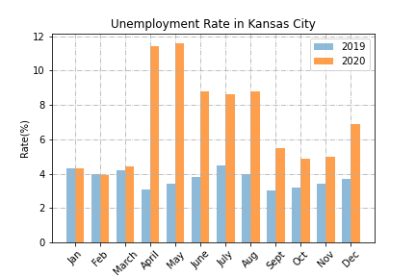
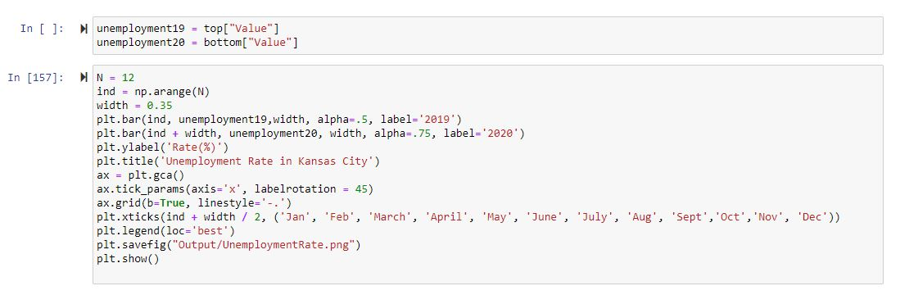
QUESTIONS
DATA ANALYTICS (ONLINE)
DATA SUMMARY
DATA EXPLORATION
UNEMPLOYMENT
ANALYSIS
SUMMARY
IMPLICATIONS
FOR REVIEW
GROUP 4: PROJECT 1

Slide 16
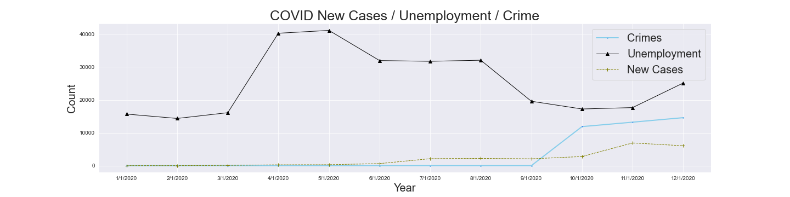
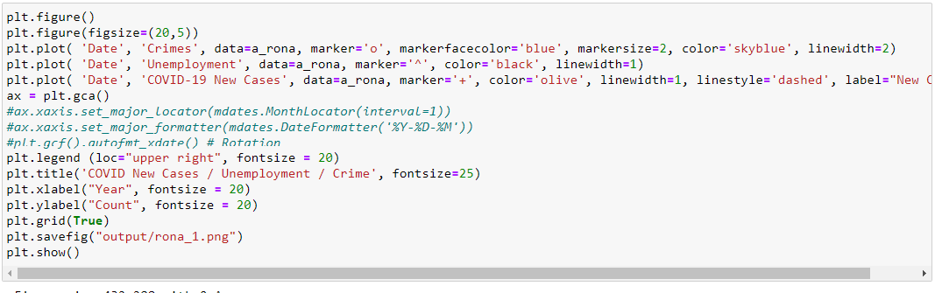
20,5))
QUESTIONS
DATA ANALYTICS (ONLINE)
DATA SUMMARY
DATA EXPLORATION
ANALYSIS
SUMMARY
IMPLICATIONS
FOR REVIEW
GROUP 4: PROJECT 1

Slide 17
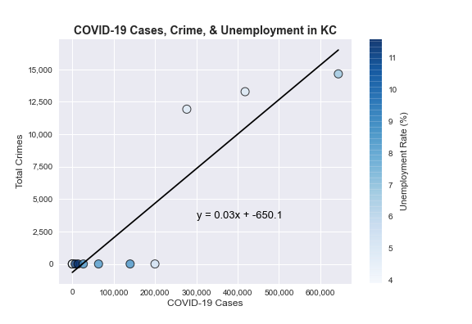
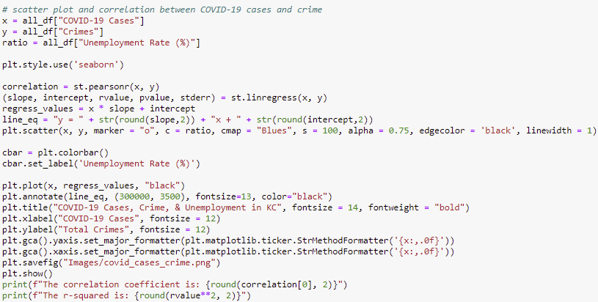
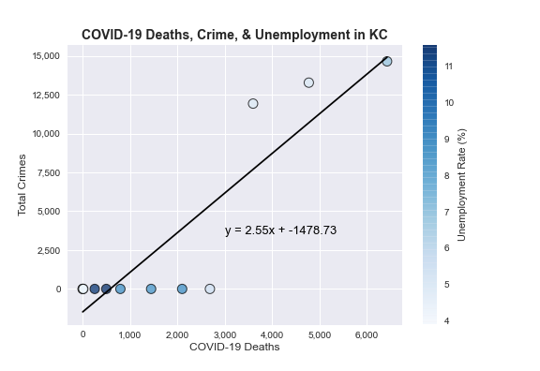
QUESTIONS
DATA ANALYTICS (ONLINE)
DATA SUMMARY
DATA EXPLORATION
ANALYSIS
The correlation coefficient is: 0.91 The r-squared is: 0.82
SUMMARY
IMPLICATIONS
FOR REVIEW
The correlation coefficient is: 0.89 The r-squared is: 0.8
GROUP 4: PROJECT 1

Slide 18
QUESTIONS
DATA ANALYTICS (ONLINE)
DATA SUMMARY
With the strong correlation between Covid-19 cases and Deaths, this gives us a strong correlation to form a good base to apply this correlation to unemployment and crime to see if there is a relationship to crime and unemployment as seen in these two graphs.
DATA EXPLORATION
The r-squared is: 0.9825204775479639
ANALYSIS
SUMMARY
IMPLICATIONS
The r-squared is: 0.9878841847717416
FOR REVIEW
GROUP 4: PROJECT 1

Slide 19
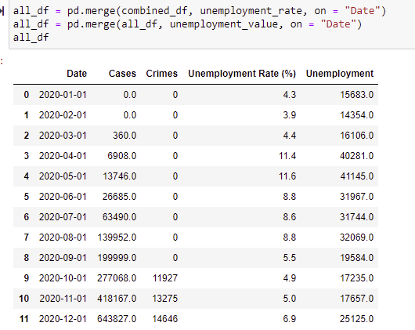
QUESTIONS
DATA ANALYTICS (ONLINE)
DATA SUMMARY
COVID-19 may have caused an increase in crime in KCMO, Crime shows a strong, positive correlation between COVID-19.
With a Correlation coefficient at 0.91 and r-squared of 0.82 between cases and crime incidents.
There lies a similar relationship between coronavirus deaths and crimes in the Kansas City area.
2)Thefts and sexual offenses decreased pre-to-post COVID-19 outbreak, while (theft from/of vehicle), assault, robbery, property crime, quality of life, breaking & entering, and homicide incidents increased.
3) Unemployment and crime were negatively correlated during the entire timeframe of this study. However, if we only look at October-December 2020, both values increase at the same time. (See Image 1) Again, this goes back to the quality of the crime data.
DATA EXPLORATION
ANALYSIS
SUMMARY
IMPLICATIONS
FOR REVIEW
GROUP 4: PROJECT 1

Slide 20
QUESTIONS
DATA ANALYTICS (ONLINE)
DATA SUMMARY
1)Crime Api had large gaps the data is inconclusive due to the large gaps from inconsistent reporting.
2) Hoped that all relationships regarding Covid were linear, this was not the case. Made relating the three subjects of New Cases Deaths and Cases (total) hard to find a correlation
3) Limited data, with unemployment somewhat difficult to place in a proper data frame due to specific naming conventions for Date and Time.
3a)Data lacked specificity seen in Crime Breakdown
4) Initially we believed that having more people in the group would be beneficial to workflow and amount of work, but we discovered that working in small teams provided an atmosphere of clarity and more efficient use of time due to streamlined process development
DATA EXPLORATION
ANALYSIS
SUMMARY
IMPLICATIONS
FOR REVIEW
GROUP 4: PROJECT 1

Slide 21
QUESTIONS
DATA ANALYTICS (ONLINE)
DATA SUMMARY
For Covid19 Data would like to see demographic information included into the dataset
To include access to Hospitalization and proper healthcare
How were cases discovered, data did not indicate how new cases were revealed
Timeseries for different types of crimes with higher quality data
Would have liked to present data in a geospatial context using heatmapping
We cannot quantify the amount of geopolitical influence that might have resulted in causation for crime and unemployment
Did people leave the workforce and not reenter for fear of contracting the virus or did they get laid off
Did people find secondary employment
DATA EXPLORATION
ANALYSIS
SUMMARY
IMPLICATIONS
FOR REVIEW
GROUP 4: PROJECT 1

Slide 22
QUESTIONS
DATA ANALYTICS (ONLINE)
DATA SUMMARY
DATA EXPLORATION
ANALYSIS
QUESTIONS?
SUMMARY
IMPLICATIONS
FOR REVIEW
GROUP 4: PROJECT 1

